Slide 1
week3

Slide 2
Rewind week2
work | progress
Exploring a new database retrieval and code fetching | Aims2 to explore Cmip6 to get content
Compare the plot:1. between models, 2.to tif file | 1.Check✅ 2.Next pages
Simple plotting | check✅
Masked to Land Region Only | check✅
Paper research | Later pages

Slide 3
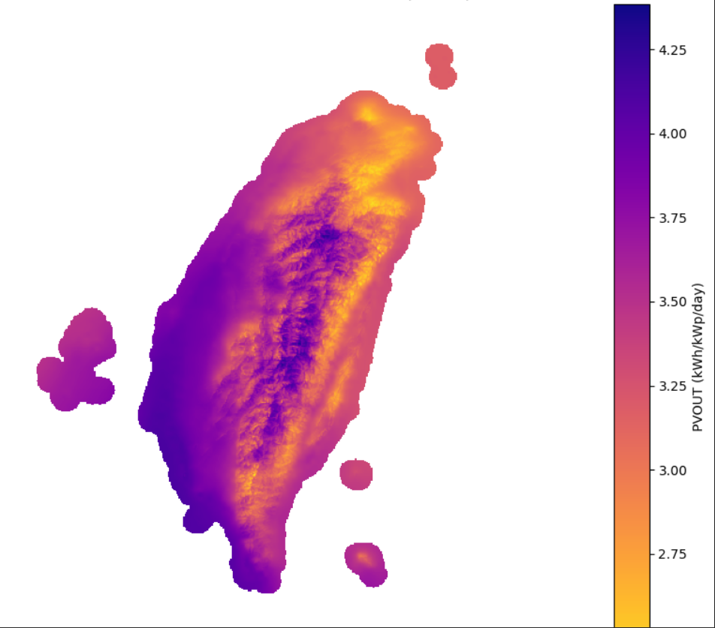
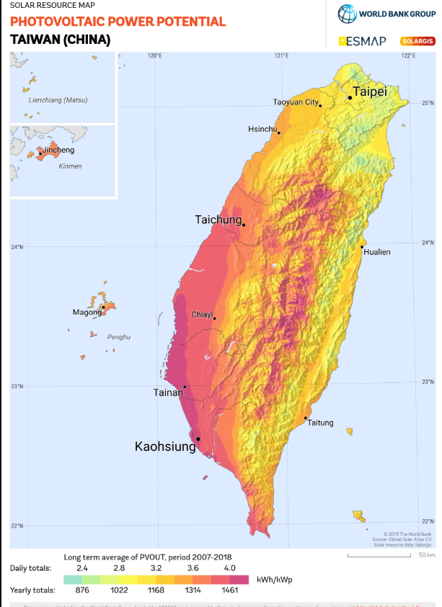
Solar atlas
For solar resource (GHI, DNI, DIF, GTI) and PV power potential (PVOUT) two temporal representation of data was prepared: • Longterm yearly/monthly average of daily totals (LTAym_AvgDailyTotals) • Longterm average of yearly/monthly totals (LTAym_YearlyMonthlyTotals) Both types of temporal data representations are equivalent, you can select the aggregation of your preference. The relation between datasets is described by simple equations: • LTAy_YearlyTotals = LTAy_DailyTotals * 365.25 • LTAy_MonthlyTotals = LTAy_DailyTotals * Number_of_Days_In_The_Month

Slide 4
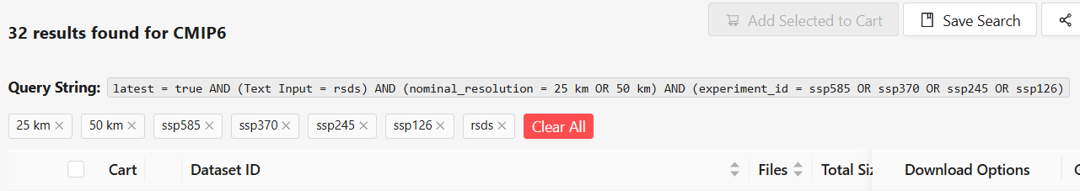
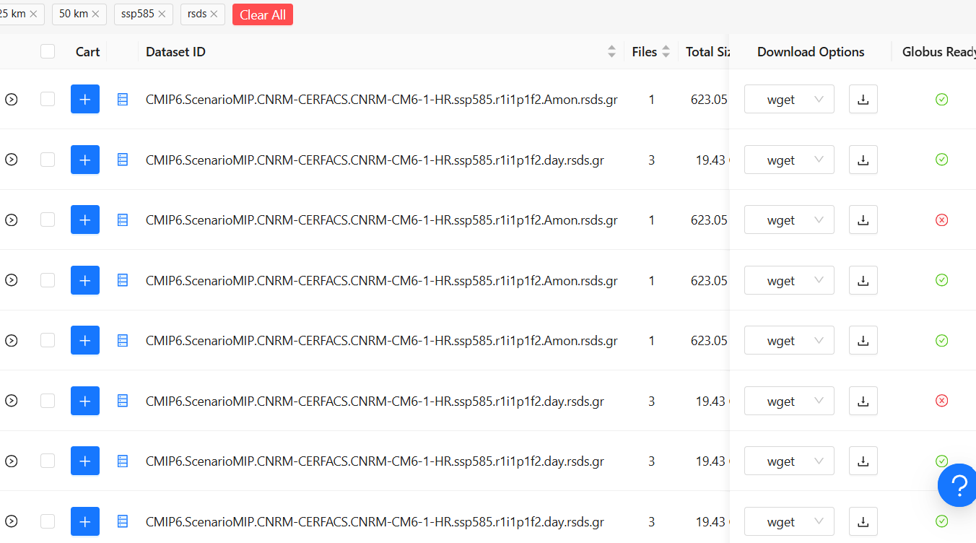
Use ESGF variable tables to check the id of variables
The best resolution on this dataset are the cnrm we use(50km)

Slide 5
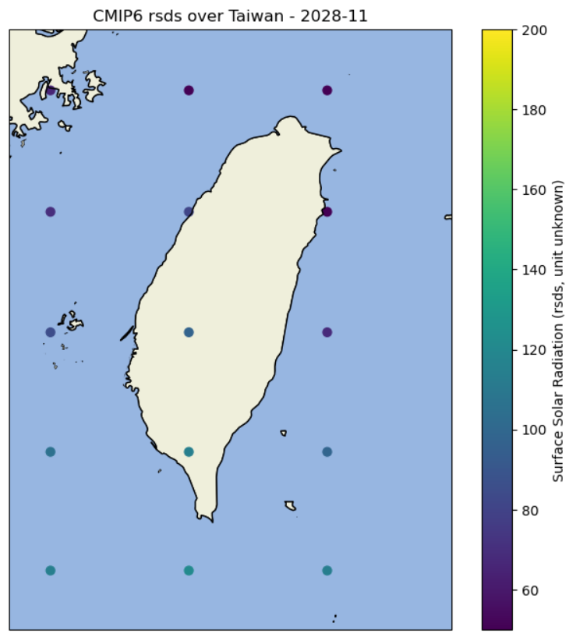
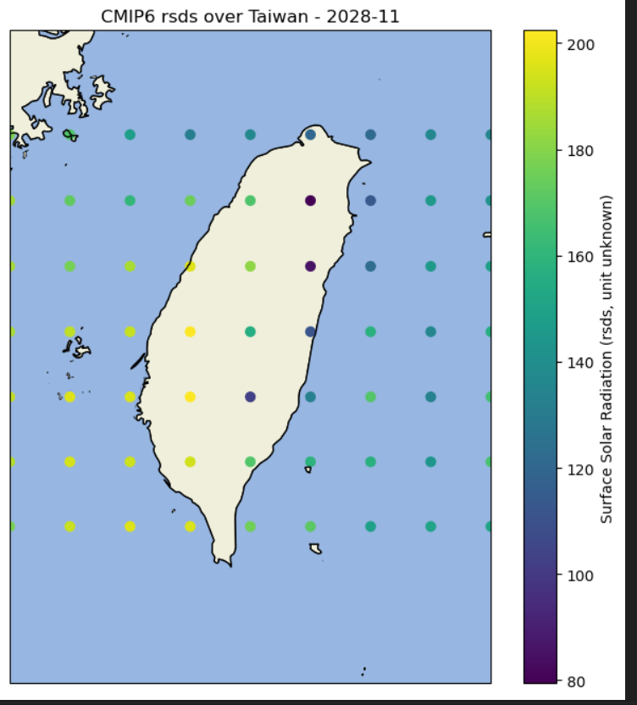
Plot comparison
1*1.25, gfdl(claimed to have 0.5*0.25, I may get the wrong dataset)
0.5*0.5, cnrm

Slide 6
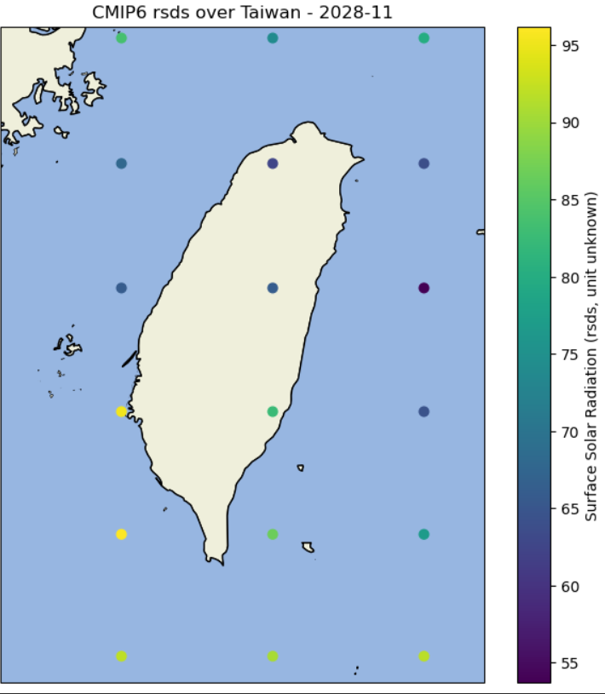
Model: TaiESM1, develop by taiwan, base on cesm, 1*1.25
團隊以台灣的名義，以TaiESM1與HiRAM參與第6期耦合模式比對計畫CMIP6，該計畫為IPCC AR6報告所採用的科學基礎，證明我國發展的氣象模擬模式在40個國家地區提出的模式中，根據計算積分和日本氣象廳相當，優於韓國、中國等所提出的模式。
與原型CESM相比，TaiESM主要升級的地方在於「對流與雲」、「雲與氣膠」、「地形與輻射」、「海氣交互作用」等幾個部分
The comparison between models are not so good, but it still has some comparable parts, when apply to the contour map

Slide 7
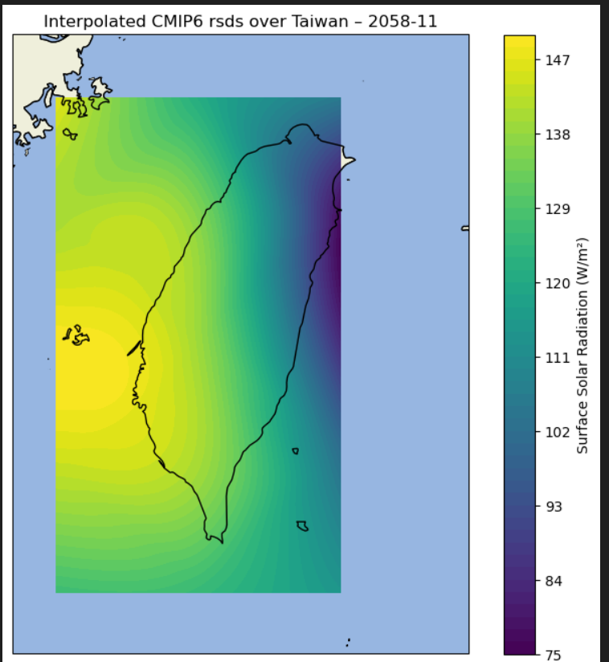
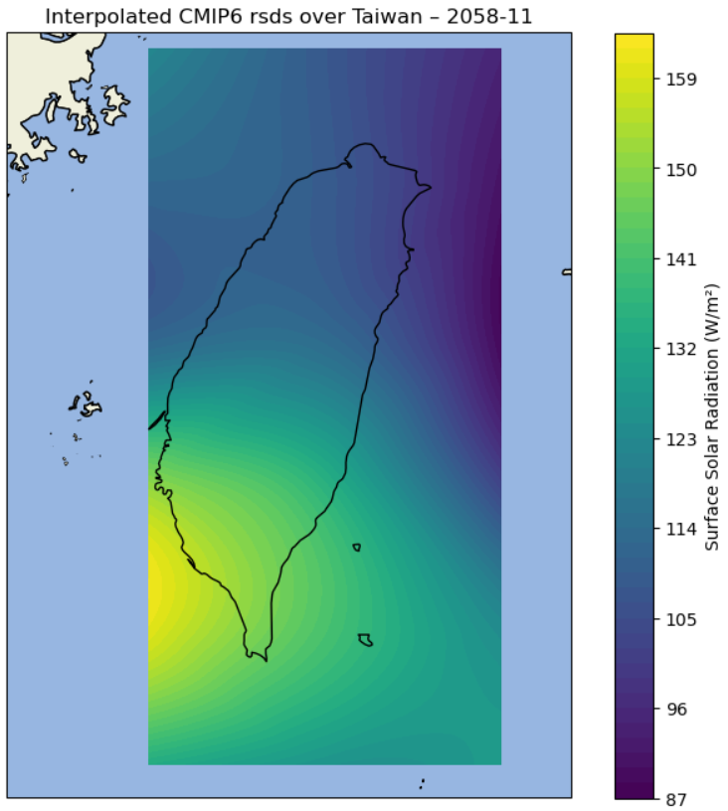
taiesm1
gfdl

Slide 8
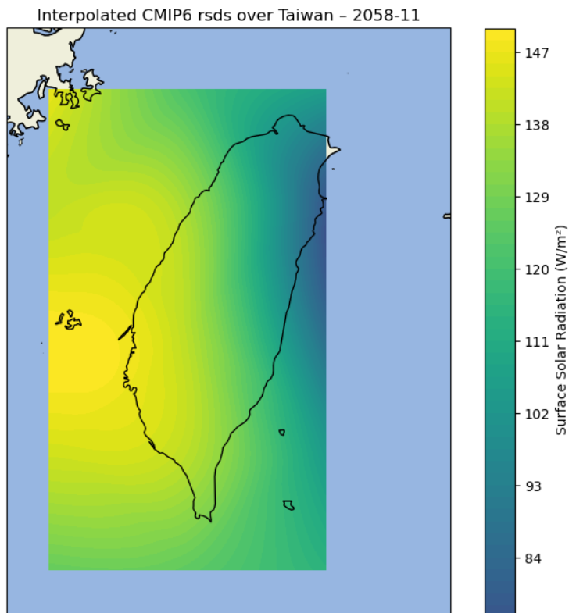
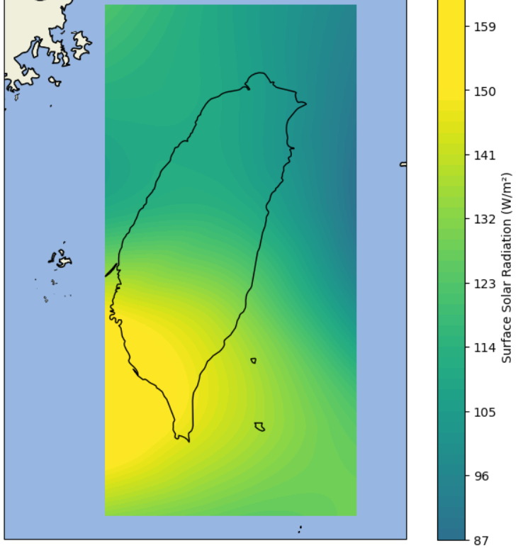

Slide 9
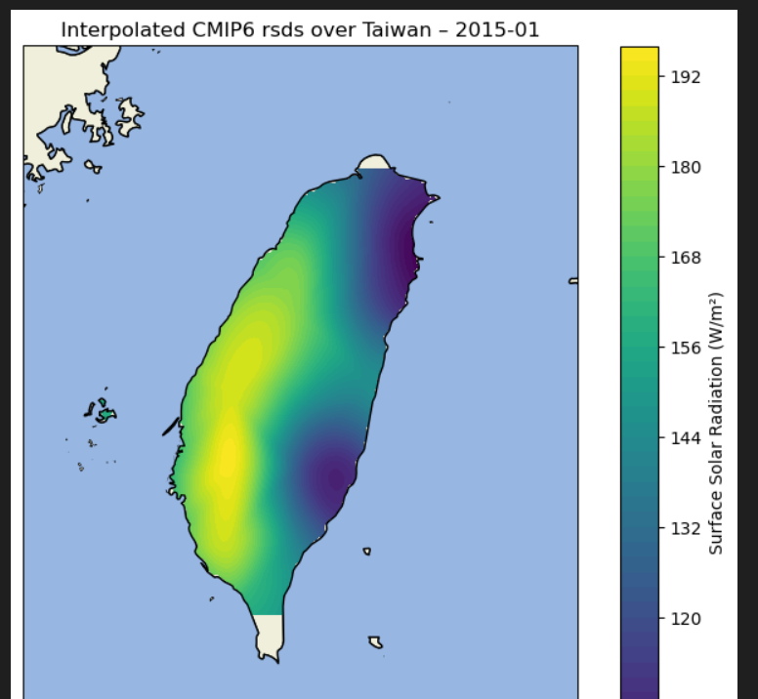
Masked contour map

Slide 10
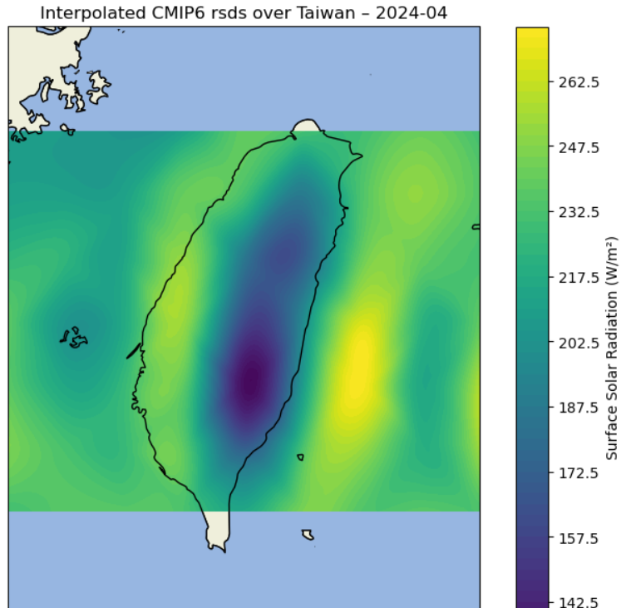
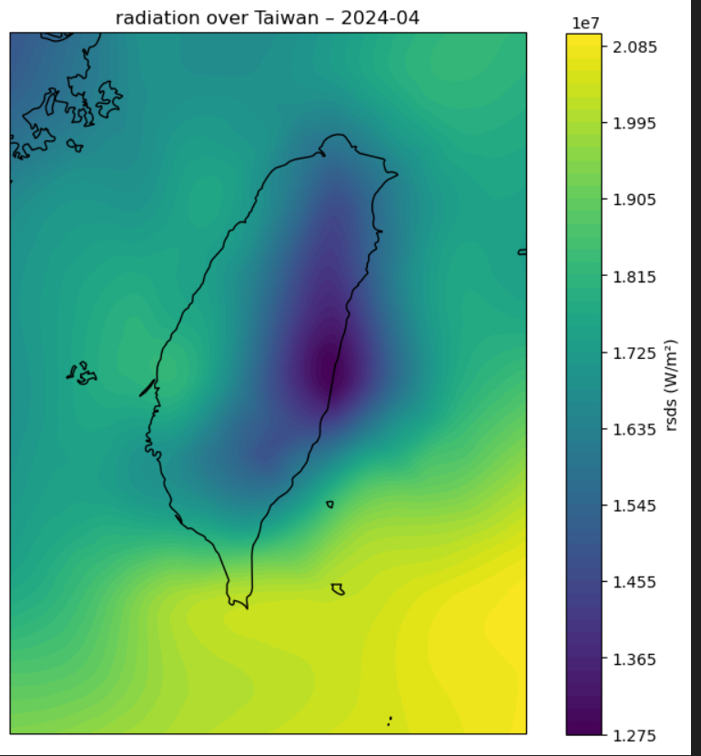
Plot comparison (w ERA5)

Slide 11
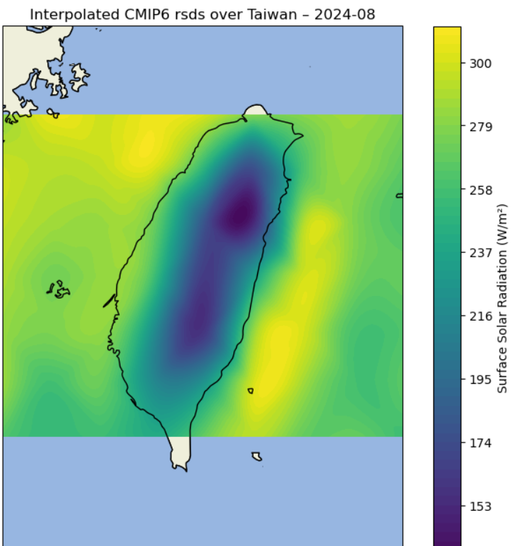
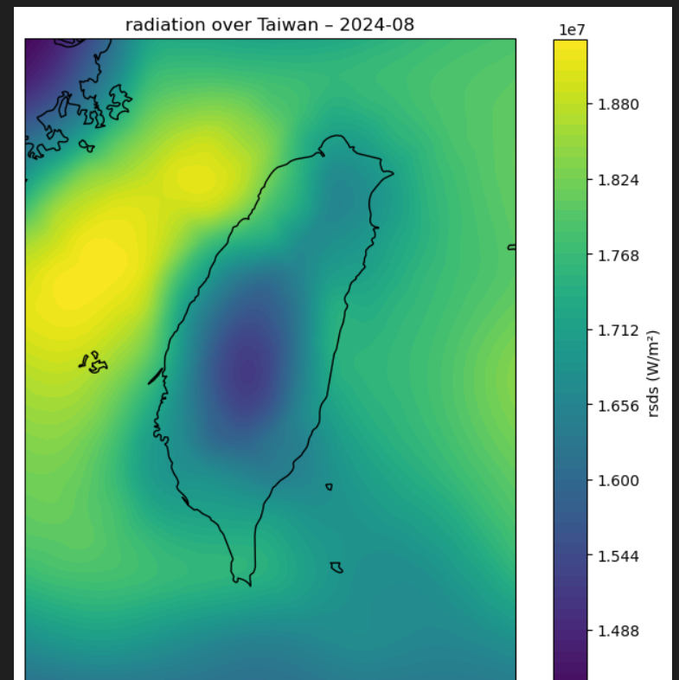
Plot comparison (w ERA5)

Slide 12
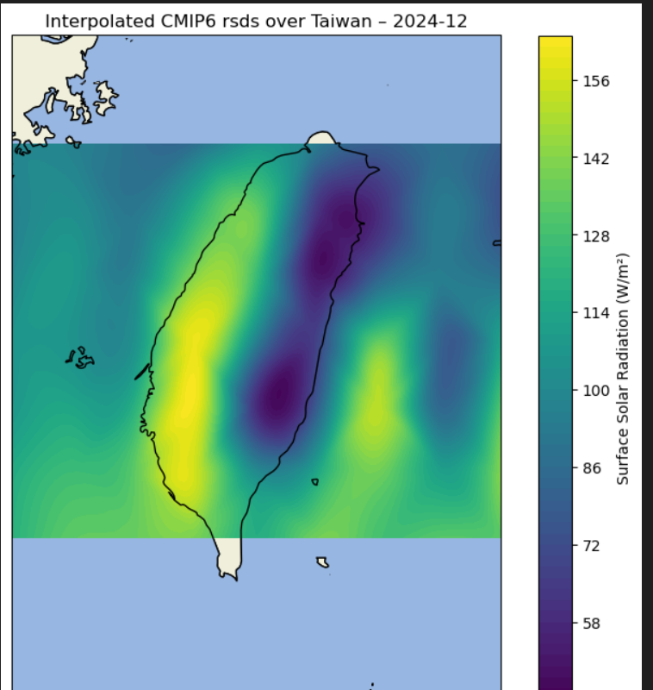
Plot comparison (w ERA5)

Slide 13
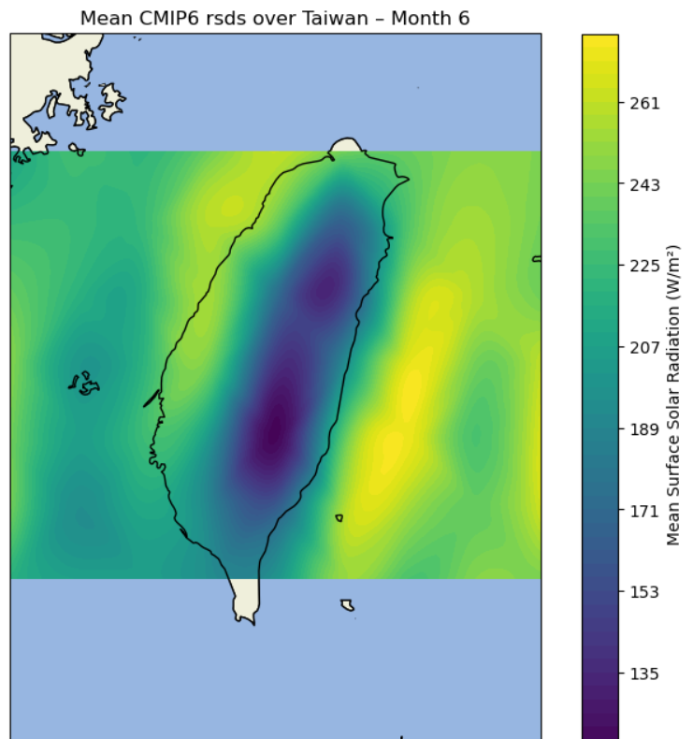
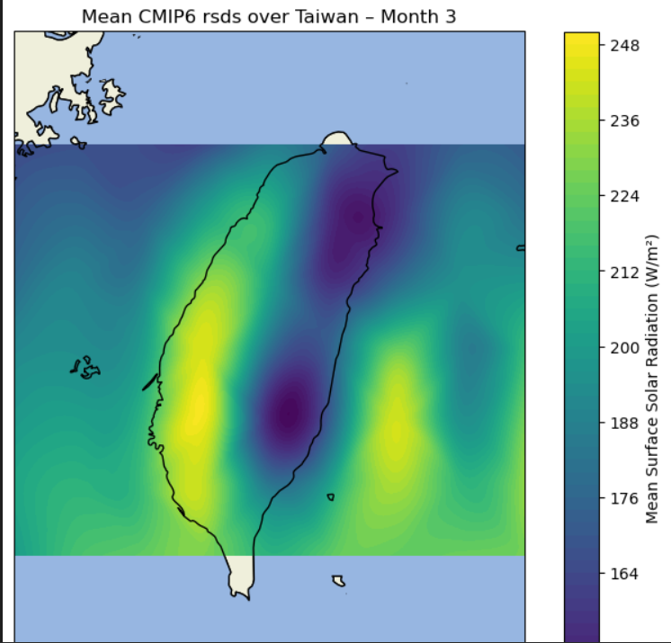
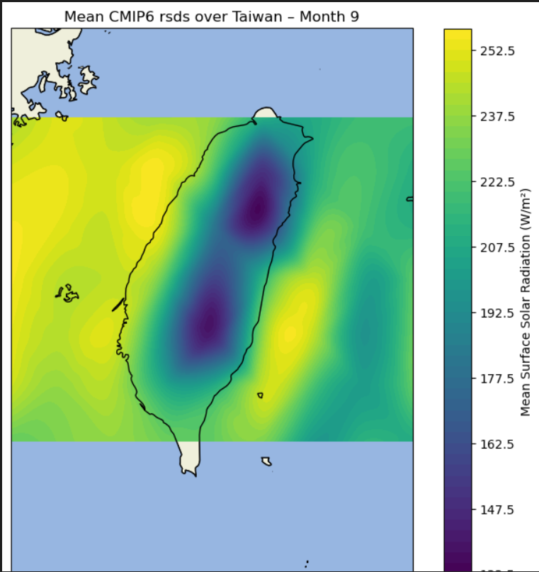
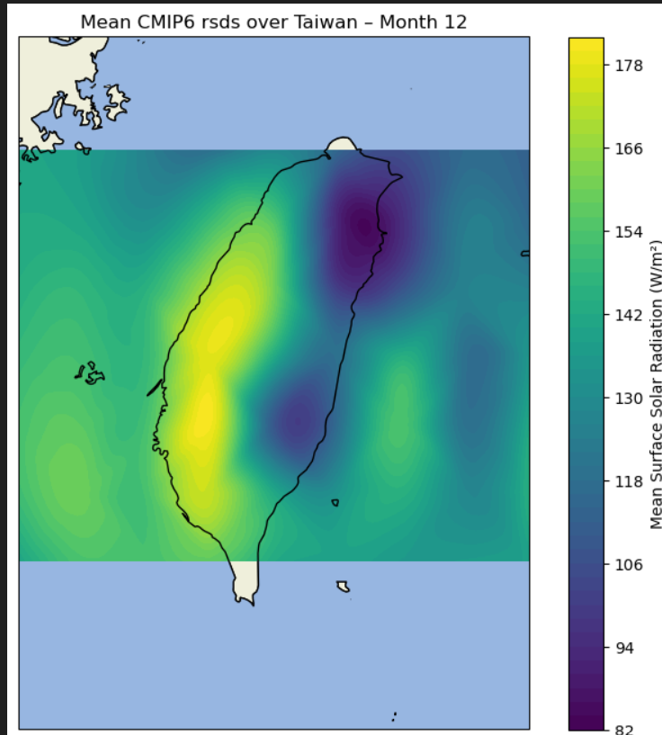
Seasonal analysis (cnrm)
the plot do have some continuity through a year

Slide 14
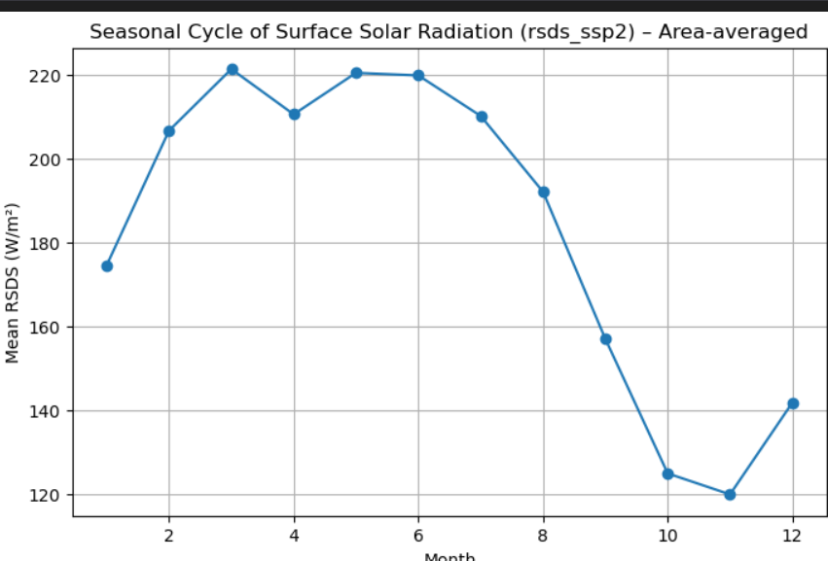
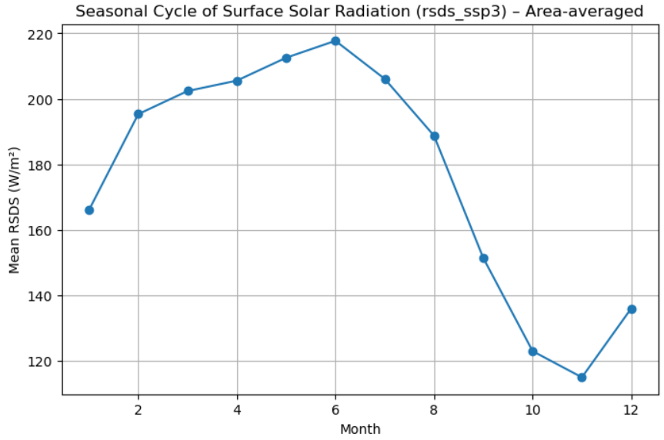
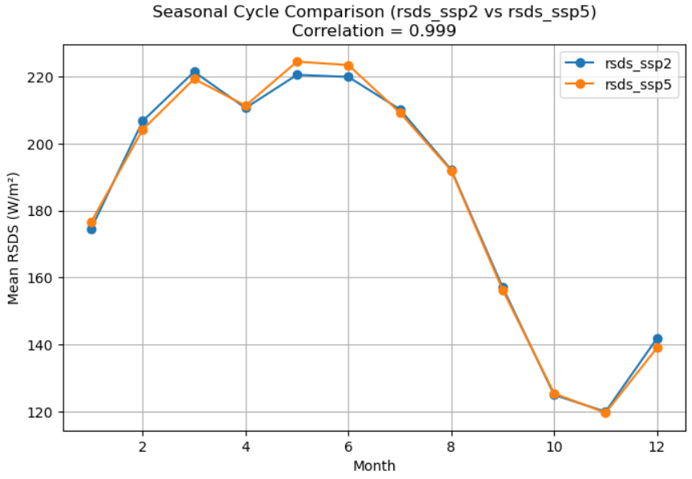
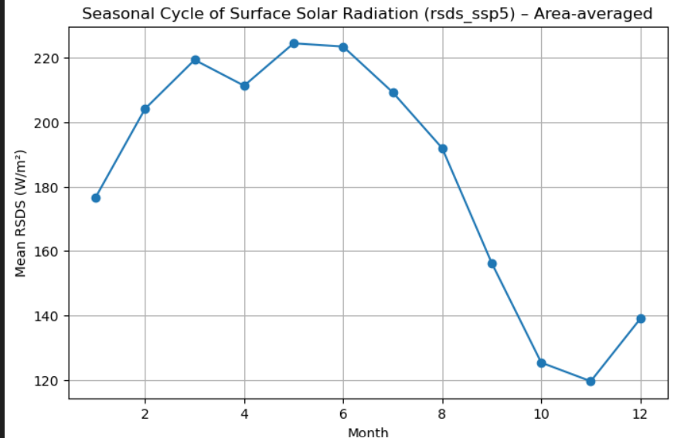
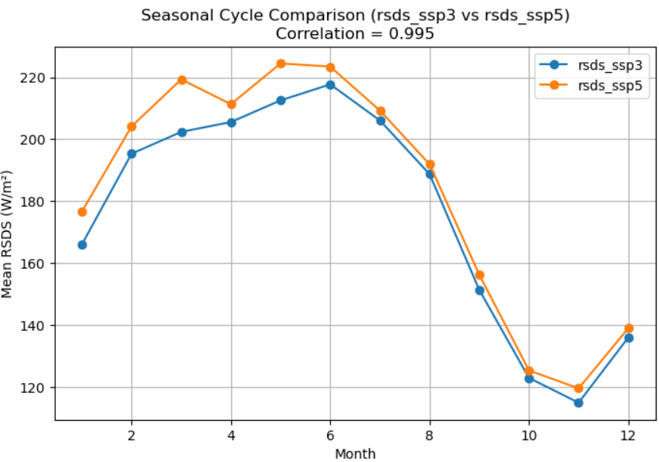
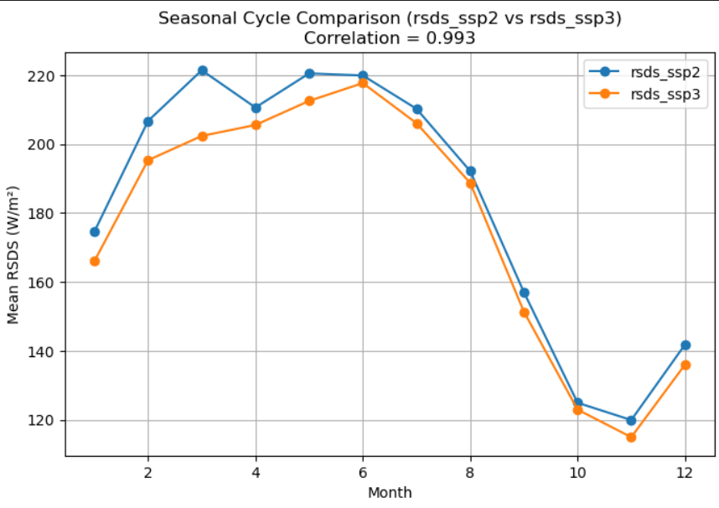
It’s weird that ssp2 and ssp5 has obvious correlation, but not so much ssp3,still the trend are similar still

Slide 15
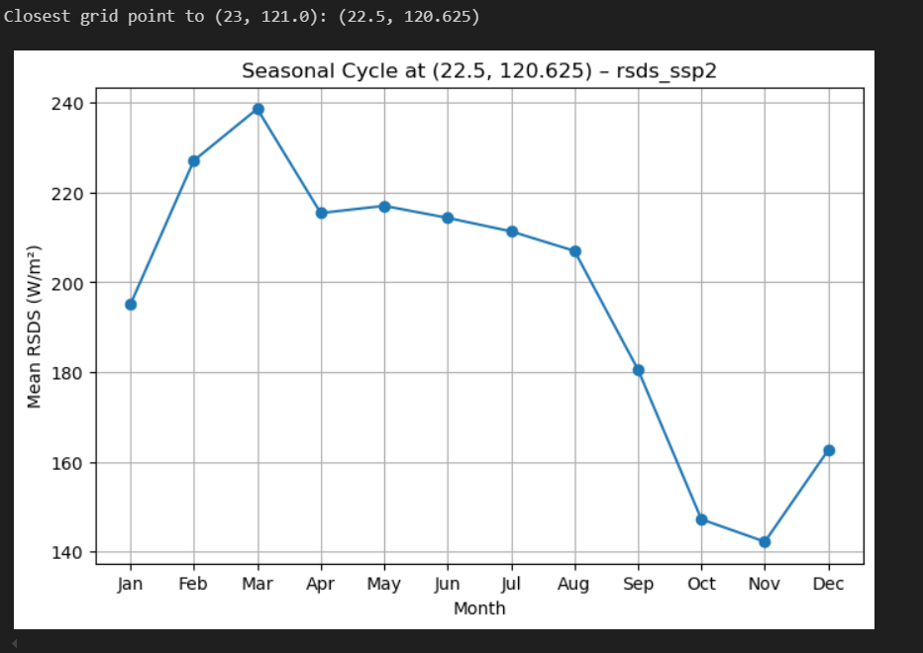
A closest grid seasonal cycle plot, aim at further interpolation to compare arbitrary point on the map, then thus give a better data for spatial analysis

Slide 16
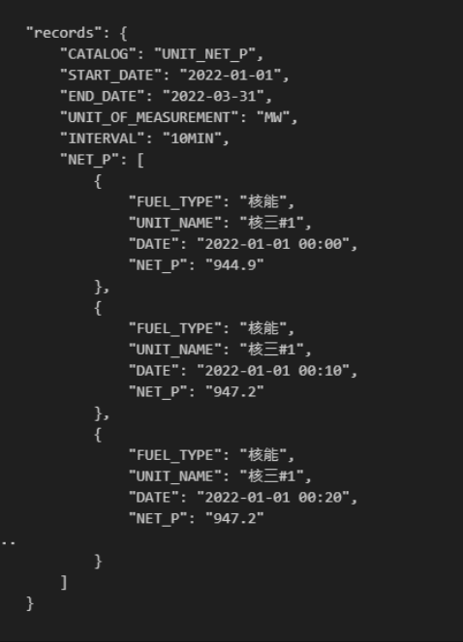

Power generation
Due to some unknown issue, the unzipping fails on my laptop
Due to some unknown issue, the unzipping fails on my laptop

Slide 17
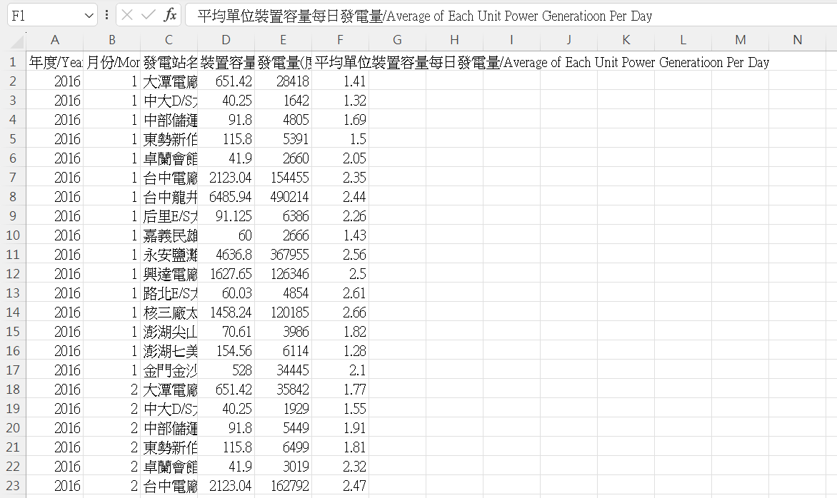
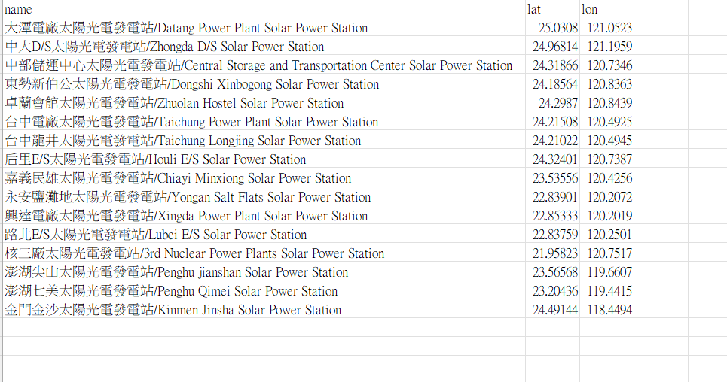
Solar power plant data
Arrange the coordinate by g-map
Haven’t write the code to compare

Slide 18
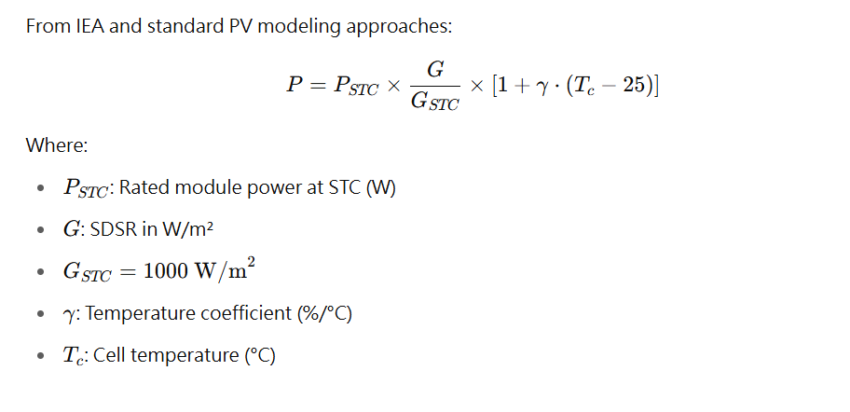
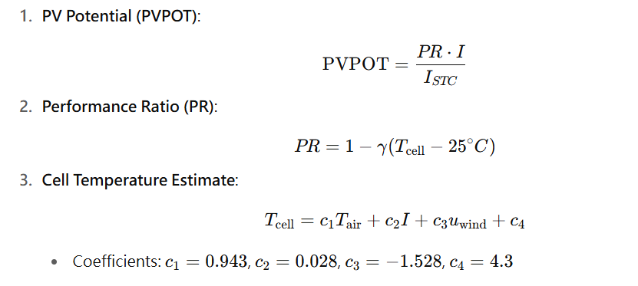
Rsds and pv out
From key paper

Slide 19
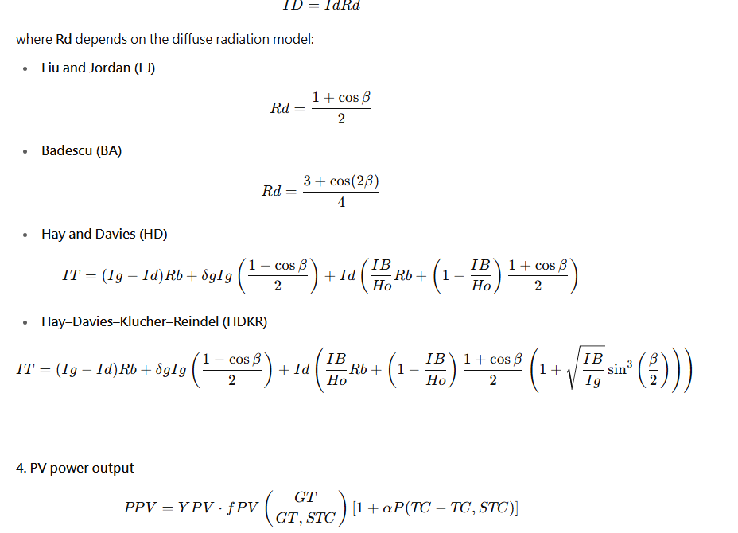
Sdsr x optimal angle
From:Estimation of Solar Radiation on a PV Panel Surface with
an Optimal Tilt Angle Using Electric Charged
Particles Optimization
Muhammad Saud Khan

Slide 20
Overview:downscaling/ interpolation Effect on Solar Power Potential
Spatial Interpolation Techniques
Various interpolation methods, such as Inverse Distance Weighting (IDW), have been evaluated for their effectiveness in estimating solar energy potential. For instance, studies have indicated that the IDW approach with a power of 5 yields superior results compared to classical interpolators, particularly in complex terrains. The precision of these interpolation methods is crucial, as the accurate representation of solar radiation across different geographical locations can directly affect the feasibility and efficiency of solar energy installations.
.Downscaling Methods
Temporal and spatial downscaling techniques are essential for capturing the diurnal and seasonal variations in solar radiation. These methods allow for a more detailed modeling of solar irradiance that aligns closely with real-world conditions. For example, the implementation of functional principal component analysis (FPCA) facilitates the development of a diurnal template model, which can be adapted to work across larger regions, thereby enhancing the robustness of solar radiation predictions.
From:Influence of design data availability on the accuracy of physical photovoltaic power forecasts

Slide 21
Downscaling v.s. Spatial Interpolation
A. Downscaling:
Dynamical downscaling: Using a Regional Climate Model (RCM) driven by GCM/reanalysis to produce finer resolution outputs. Computationally heavy.
Statistical downscaling: Using statistical or machine learning relationships between large-scale predictors and local observations to infer high-resolution conditions.
B. Spatial Interpolation
Spatial interpolation is a process to estimate values at unmeasured locations based on known data points.
Inverse Distance Weighting (IDW)
Kriging(a more common way to do)
Spline interpolation(the one pygrid apply)

Slide 22
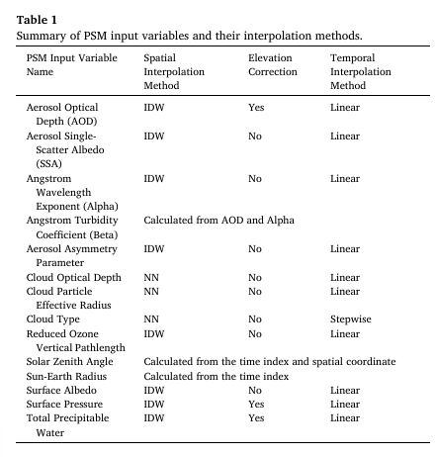
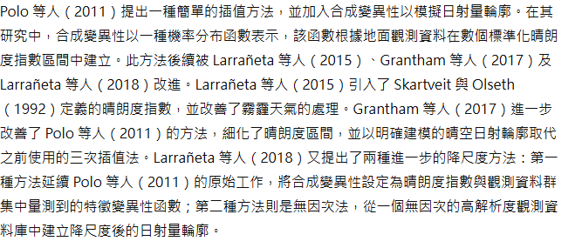
A physical downscaling algorithm for the generation of high-resolution spatiotemporal solar irradiance data
NSRDB: Provides 30-min, 4 km × 4 km resolution solar data.
Apply:Solar modeling tools (e.g. SAM, IGMS) https://www.pvsyst.com/
Uses Inverse Distance Weighted (IDW) interpolation for continuous atmospheric variables (e.g. aerosol optical depth, temperature, pressure).
fine-scale cloud variability drives PV output fluctuations, the method adds synthetic variability:Uses a triangular distribution based on the clear-sky ratio (predicted irradiance / clear-sky irradiance).
Validate by SURFRAD ground measurements: Showed comparable accuracy to native NSRDB, despite added synthetic variability.

Slide 23
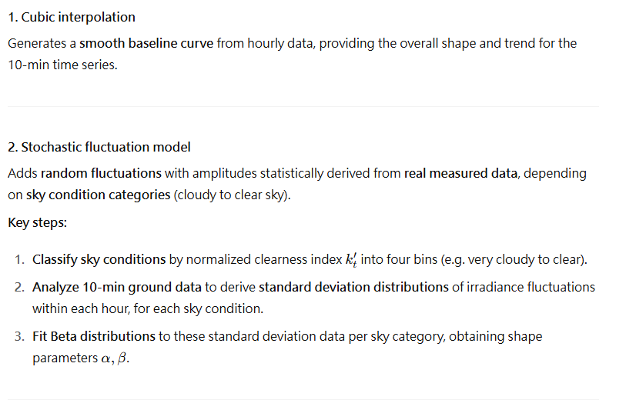
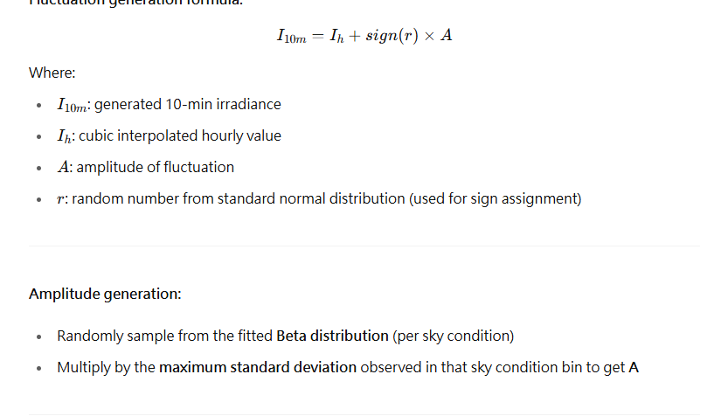
A simple approach to the synthetic generation of solar irradiance time series with high temporal resolution
Introduces simple, computationally efficient synthetic downscaling Captures statistical characteristics of sub-hourly fluctuation
Ensures energy conservation over daily/monthly scales

Slide 24
Challenges encountered
1. the repo of github: (haven’t fork this repository ) 問題應該不大只是還沒授權共編
2.the differences between models are somehow significantly as I show, but the three simulations in a models got no significance
3. the three models use different way to encode the date, and the dating is a mess on gfdl model, prolly due to the date conversion
4.still don’t have organized way to deal with the power genreation zip
5.Unit conversion(shall be easy but haven’t be done)
6.the arranging of the monthly output from each power plant, since the
Power plant labels are added through time, so the splitting is tricky
整體來說這幾天的主題稍稍離題，因為沒有花費夠多時間搞定
Power generation 的 json
work | difficulties | completeness
1 | low | 0%
2 | high | Less than10%
3 | Low-mid | 80%
4 | mid | 20%
5 | low | 20%
6 | Low-mid | 0%

Slide 25
Topics wanna discuss
1. Research direction to the downscaling and recommended method to try
2.How to deal with the difference between models
3.The recommended method to further tackle the data’s significance below expectation to the different scenario

Slide 26
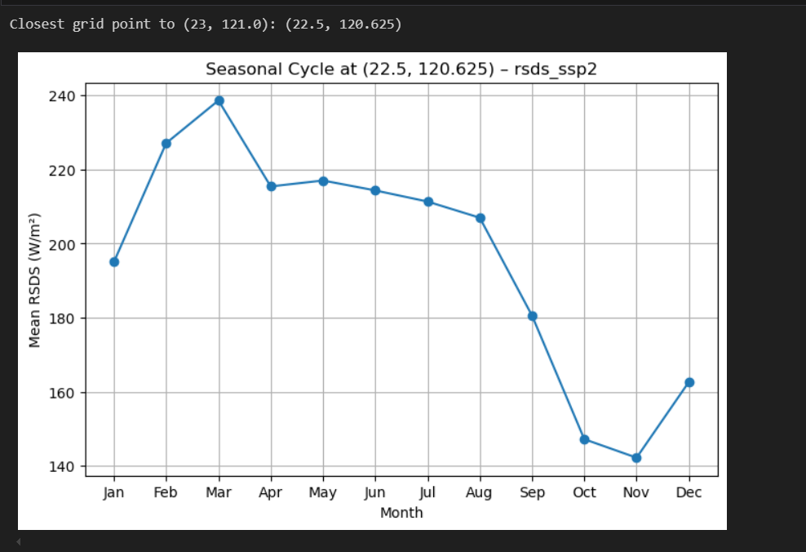
Planned progress and expected outcomes
1.update the code and data csv onto github
2.study more on paper related to downscaling (scikit-learn / xgboost / LightGBM for statistical downscalingPyKrige / GSTools for kriging-based interpolation)
3.make sure the power generation. Json is readable and can be apply on the comparison
4.briefly compare the data with basic interpolation method pvout and the real data, focus on the time span 2016-2020
a. arrange the location index ✅
b. arrange the power plant output data by month, just like :
c. get the spatial analysis cell, from nearest to linear, then try the kriging by pykrig modules (exploring)
d. turn the sdrs into pvout by formula given by paper, set the ref temp =25 to exclude the effect of temp
e. compare the data

